Slide 1

EMERGING TRENDS IN SOFTWARE
Samuel De Jesus Da Cunha
01 June 2026

Slide 2



OUTLINE
Executive Summary
Introduction
Methodology
Results
Visualization – Charts
Dashboard
Discussion
Findings & Implications
Conclusion
Appendix

Slide 3

EXECUTIVE SUMMARY
Summarize key findings here
Data collection
Data wrangling
Find duplicates
Removing duplicates
Normalizing data
Exploratory data analysis
Data visualization
Create Dashboard

Slide 4

INTRODUCTION
Purpose of the report, Target Audience & Value of the analysis
Stack Overflow
Problem
Question to ask
What to look for

Slide 5

METHODOLOGY
Data sources, Data collection & Data wrangling steps
Data collection and wrangling
Jobs API
Web scraping salaries
Survey results
Data analysis and visualization
Ecploring data
Analysis data
Create dashboard

Slide 6
Results
Look data from survey, make decisions, analyze and create presentation

Slide 7
JOB POSTINGS

Slide 8
POPULAR LANGUAGES

Slide 9
PROGRAMMING LANGUAGE TRENDS
Summarize key trends shown in the charts.
Current Year
Next Year

Slide 10
PROGRAMMING LANGUAGE TRENDS - FINDINGS & IMPLICATIONS
Findings
Python Takes the Lead
Rust and Go enter strongly as modern alternatives.
C completely exits the Top 10 list; C++ falls to last place.
Implications
AI & Data Science Boom Python's rise confirms massive industry alignment with AI/ML.
Infrastructure Modernization
Transition from C/C++ to Rust/Go highlights safety and cloud performance.
Stack Fragmentation
Lower overall volume points to developer dispersion into niche tools.

Slide 11
DATABASE TRENDS
Summarize key trends shown in the charts.
Current Year
Next Year

Slide 12
DATABASE TRENDS - FINDINGS & IMPLICATIONS
Findings
PostgreSQL Undisputed Leader
Supabase successfully debuts in the Top 10 list for next year.
Massive volume reduction for mainstays like MySQL, SQLite, and MongoDB.
Implications
PostgreSQL is now the safest, most reliable bet for infrastructure investment.
Shift to Open-Source & BaaS Supabase's rise highlights the rapid adoption of cloud-native developer tooling.
Data Stack Consolidation, General contraction in mid-tier volumes suggests teams are shrinking their data stacks.

Slide 13

DASHBOARD
<https://github.com/xocafa7805-del/ibm-data-analysis

Slide 14
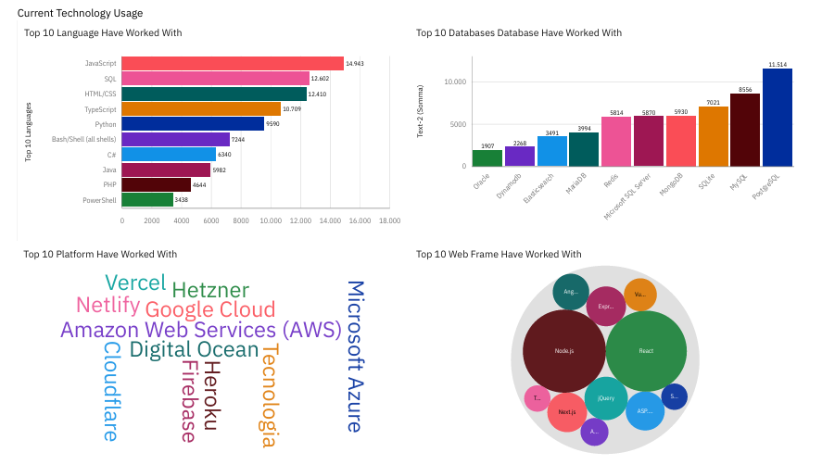
DASHBOARD TAB 1: Current Technology Usage

Slide 15
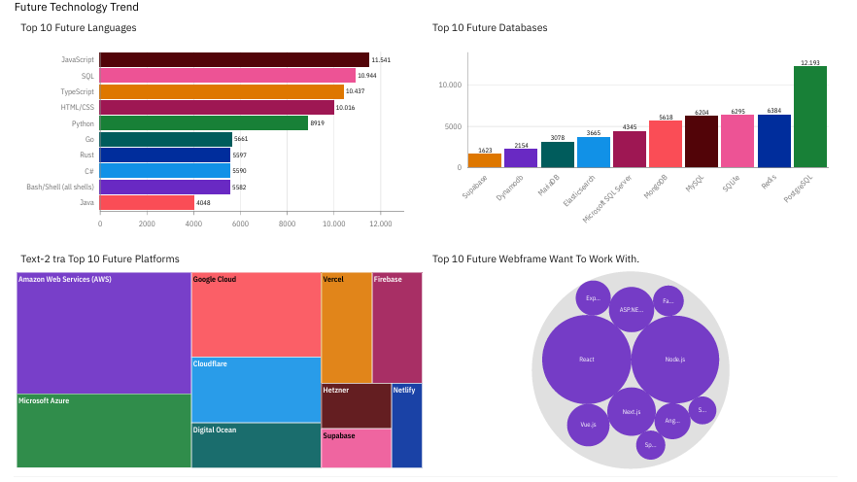
DASHBOARD TAB 2: Future Technology Trends

Slide 16
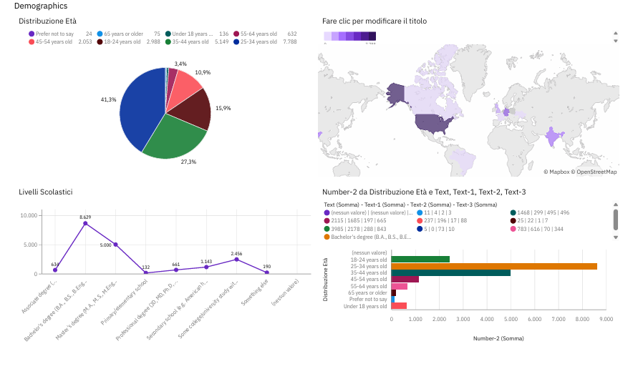
DASHBOARD TAB 3: Demographics

Slide 17
DISCUSSION
Discuss overall insights derived from dashboards

Slide 18
OVERALL FINDINGS & IMPLICATIONS
Findings
Majority of respondents are male
Most of the respondents were between the ages of 25-34
Most of the respondents are from developed english speaking nations
The most important factor for a Job is the Languages and Technologies used
Erlang has one of the highest
Implications
The respondents being more no the young side could explain the tendency to want to adopt newer languages and technologies
All the technologies in the survey are English-based, this could stem from the respondents being predominantly English
Demand and shortage of skills generate higher wages.

Slide 19

CONCLUSION
1. Python's Absolute Dominance: Python has established unmatched supremacy as the primary language developers want to work with next, heavily propelled by the massive industrial acceleration of Artificial Intelligence, Machine Learning, and Data Science.
2. Modern Systems Migration: There is an active system-level shift away from legacy setups; traditional systems programming in C and C++ is visibly contracting as developers strongly favor modern, memory-safe, and concurrent languages like Rust and Go.
3. PostgreSQL Consolidation: PostgreSQL remains the undisputed cornerstone for relational database design. Simultaneously, the rapid debut of lightweight open-source alternatives like Supabase signals a rising developer appetite for agile, cloud-native backend tooling.
4. Youth-Driven Innovation: A highly concentrated demographic in the 25-34 age bracket (41.3% of the survey_data.xlsx dataset) acts as the core driver for rapid technological adoption, bypassing rigid enterprise platforms in favor of flexible, community-driven ecosystems.

